Slide 1
The Local Changemakers Course

Slide 2
SESSION 8
Our Change Journey
Notes:
Display this slide during the opening exercise.

Slide 3
What is an action plan and why is it important?
Notes:
Slides 3-24 illustrate the session 8 presentation.
Presentation: Our Change Journey
So, what is an action plan and why is it important? An action plan is a plan for HOW we want to get from where we are, to where we want to be.
If we are going on a long journey, it is a good idea to have a map and a plan for how we will travel. Perhaps we will walk to the bus stop, take a bus and then a train, and then hire a car to drive to our final destination! Without a map and a plan, we might not reach our destination, or it might take us much longer to get there.

Slide 4
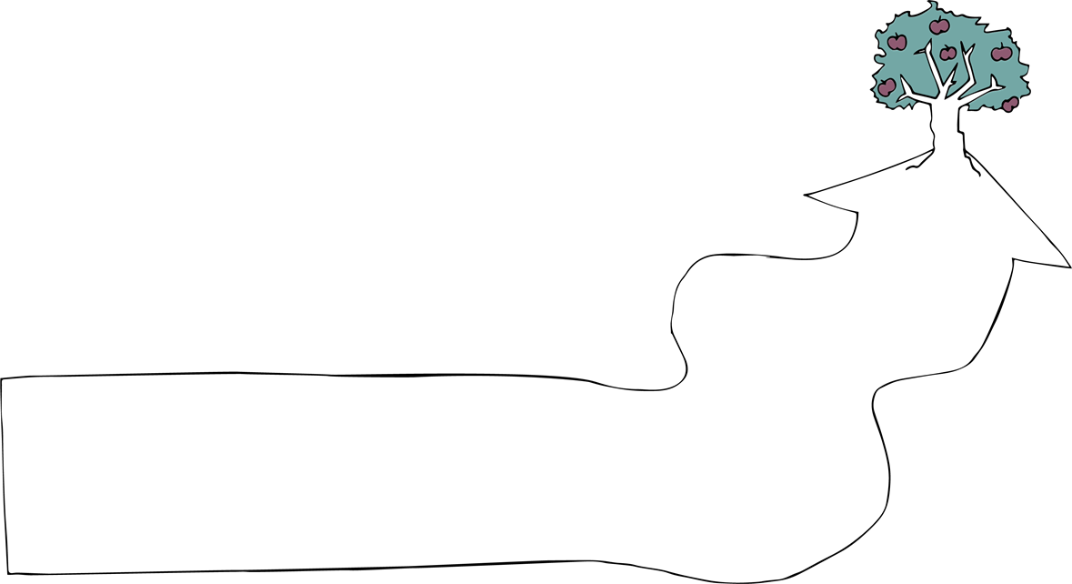
Notes:
An action plan is rather like a map and travel plan – it maps the steps we plan to take to get to our goal, and helps us to be strategic and deliberate.
We all make action plans. Sometimes they are very simple, almost instinctive, and we remember them in our heads. But for complex problems – things we’ve not done before and things we do in groups – we need to plan more carefully and write our plans down so that everyone can remember them.

Slide 5
Our change journey
Notes:
In the rest of this presentation, we’re going to learn to use a simple visual tool called ‘Our Change Journey’ to make an action plan.

Slide 6
Who are we?
Notes:
THE TRAVELLERS When we create an action plan for a journey to make change, the first question is ‘who are we?’
Who are the travellers, going on a journey to make change? Just as some travellers have to walk while others can drive or take a plane, we as individuals, groups or organisations have different opportunities, strengths and weaknesses and face different risks.
Starting by asking ‘who are we?’ helps us to keep these in mind.

Slide 7
Who are we?
Young
interfaith friends
Notes:
Let’s create an imaginary change journey and say that we are young friends from different faith communities in our town.

Slide 8
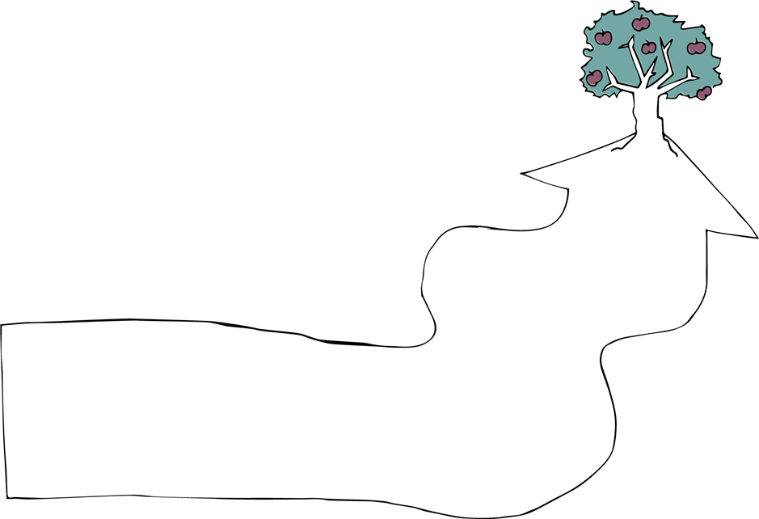
Problem
Notes:
OUR STARTING POINT When we plan a journey, the first thing we need to know is what our starting point is.
A journey of change begins with a problem, and we start by defining it.
The more specific we are about defining our problem, the easier it is to identify how to make change.

Slide 9
Problem
Children don't have friends from other faith communities.
Notes:
So instead of saying that the problem is ‘intolerance’, we might say that ‘Children do not have friends from other faith communities’. This is both a result and a cause of continuing intolerance.

Slide 10
Attitudes
Problem
Behaviours
Children don't have friends from other faith communities.
Rules
Notes:
Problems like this have different underlying factors that contribute to them. These underlying factors could be:
problematic attitudes people have,
problematic behaviours – things people do
or problematic laws, rules, or policies.
Together, these attitudes, behaviours and rules create the problem. So, in relation to the problem we have identified, what specific attitudes, behaviours or rules do we want to change?

Slide 11
Parents think...
Problem
The school tolerates...
Children don't have friends from other faith communities.
Faith leader doesn’t allow...
Notes:
In relation to our example, we might say ‘Parents have negative attitudes to children having friends from other communities’, or ‘The school tolerates bullying between children of different faith communities’ or ‘A local faith leader says friendship between children of different communities should not be allowed’. These are attitudes, behaviours and rules that contribute to our problem.

Slide 12
By next year
Goal
Problem
Notes:
OUR DESTINATION When we go on a journey to make change, it’s important to know where we want to get to!
Defining our destination is tricky. We all want to reach peace, justice and non-discrimination! But we need to be concrete and realistic about what we can achieve in a particular time frame.

Slide 13
Parents encourage...
The school tackles…
Faith leaders encourage...
Goal
Children have friends from other faith communities.
Notes:
For example, our goal might be that ‘Children have friends from other faith communities’. And for that goal, we can think about what specific attitudes, behaviours or rules we want to see in place of the old, bad ones. For example: ‘Parents encourage children to have friends from other faith communities’, or ‘The school actively tackles bullying’, or ‘Faith leaders encourage friendships between communities’.

Slide 14
Parents encourage...
The school tackles…
Faith leaders encourage...
Goal
Children have friends from other faith communities.
Problem
Children don't have friends from other faith communities.
Parents think ...
The school tolerates…
Faith leader doesn’t allow…
Notes:
As you can see, our problem and goals are like mirror images of each other.
The problem and the goal cards define the framework of our change journey. Where does the process of change start and where do we want it to lead?

Slide 15
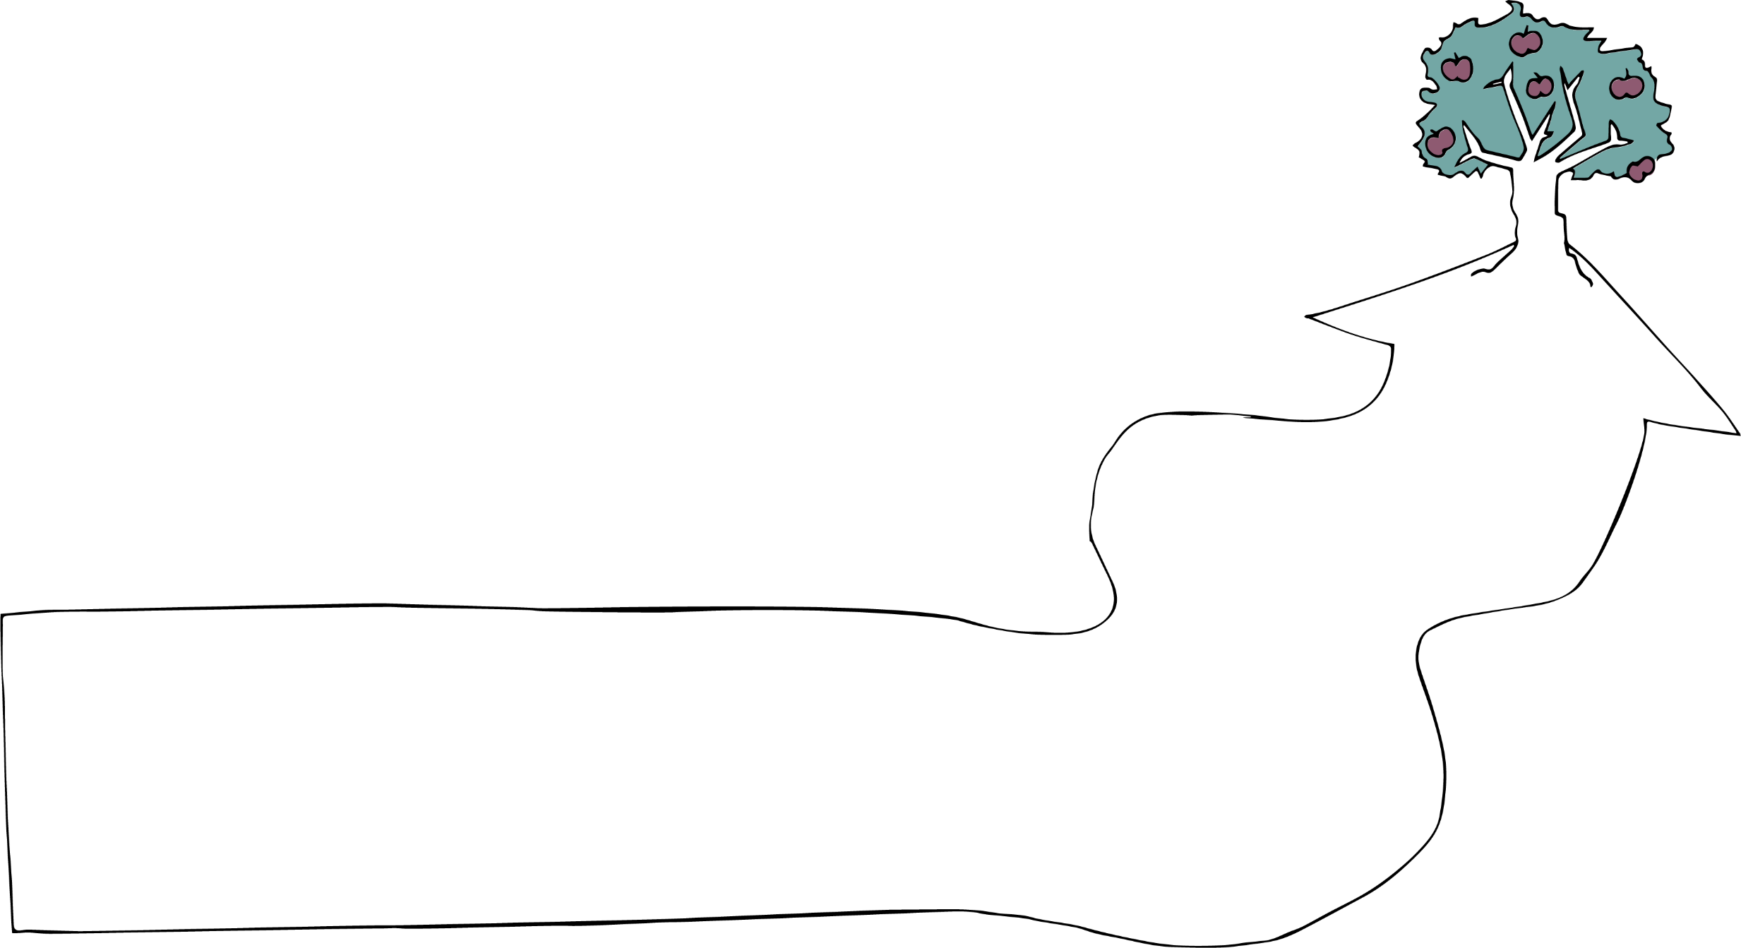
Notes:
PEOPLE WE MEET ON THE WAY On a long journey, we might meet a lot of people – fellow travellers going in the same direction, ticket officers checking on us, or people who create roadblocks that stop or divert us from the path. So, who will we meet on our journey?

Slide 16
Parents School board
Faith leaders
Children
Notes:
There will be:
people affected by the problem (children in our case),
people with power to do something about the problem (the school board and staff, parents and faith leaders, for example).

Slide 17
Intolerant social media influencer
Interfaith
council
Parents School board
Faith leaders
Children
Notes:
There may also be:
fellow travellers; people who share our goal and can help us on the road. In our example, our allies might be a local interfaith council,
or people who oppose our goal and try to stand in our way. Perhaps an intolerant social media influencer in our community.

Slide 18
Parents School board
Faith leaders
Interfaith Council
Intolerant social media influencer
Children
Notes:
As we write an action plan, it is good to think who these people, organisations and institutions are, so that we can keep them in mind as we choose our tactics and plan our actions. Who could help make change with us? Who do we need to persuade – and of what? And who might try to stand in the way of change?

Slide 19
Tactics
Notes:
CHOOSING THE ROUTE There are usually lots of different ways to get from A to B – different routes and modes of transport. So, what route will we take?
Our route is determined by the tactics we use. Remember, there are 15 different tactics to choose from – from building awareness, to advocacy, to documenting violations. We have already come up with lots of action ideas for using these tactics! This is where you can use these!

Slide 20
Tactics
Football team
Bullying survey
Persuade
Teacher award
Notes:
For our example: are we going to focus on changing the mindset of children by creating an interfaith football team, or documenting bullying incidents and using this to advocate for the school board to take action, or on creating incentives for teachers to promote positive relationships by creating an award for the teacher who best promotes diversity and ensures respect in the classroom? Or on persuading faith leaders to encourage interfaith friendships? Or a combination of these?
There are many, many different things we could do. We can’t do them all, but we may need to do more than one thing if we are going to succeed. For example, there would be no point in starting a football team if key faith leaders condemn it and no one dares to come. Successful action plans usually contain a few different but complementary tactics.

Slide 21
Steps
Football team
Bullying survey
Persuade
Teacher award
Notes:
STEPS ON THE JOURNEY Once we have decided which tactics to use, we think about HOW to use them. What concrete steps do we need to take in what order? Who will do what and when for each tactic we have chosen?
How will we practically go about organising and promoting the football team or carry out the survey? Who will talk to which faith leaders?

Slide 22
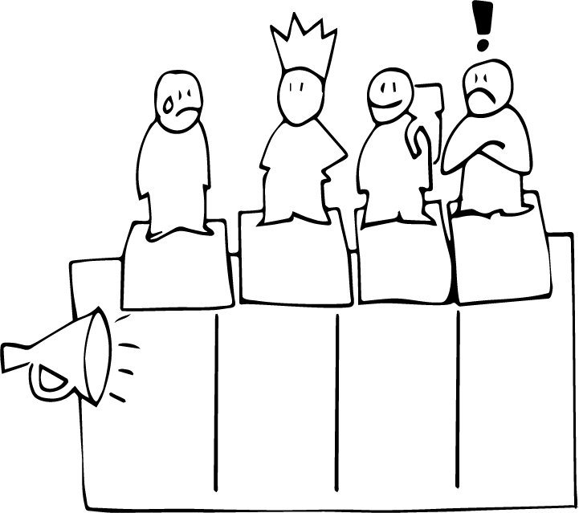
School board Parents Faith leaders
Interfaith
council
Intolerant social media influencer
Children
Message
Notes:
THE MESSAGE And when we talk to people, we need to think about what we are going to say. What kind of information or arguments will convince potential allies to join with us or convince people to change their attitudes or behaviour? What will convince powerholders to act? And are there ways of framing our message so that we avoid opposition?
For example: Parents might need to hear about the benefits of building relationships between communities for their children’s future as well as practical information that reassures them that their children would be safe and well looked after in the football team. The local interfaith council might be interested in hearing about how we will involve adults from different communities in leading the football team.
And the school board might be encouraged to hear how having an anti-bullying policy could be used to boost the profile of the school.

Slide 23
Risks
Football team
Bullying survey
Persuade
Teacher award
Notes:
OBSTACLES AND RISKS
On a long and difficult journey, travellers might face obstacles, dangers and storms that they need to avoid or overcome in order to reach their destination. All change processes involve obstacles and risks. It helps if we think ahead, choose as safe a route as possible and have plans for how to handle different situations that might arise.
So, what obstacles and risks might we face if we take the actions and steps we have envisaged? Are any of the actions too risky and are there ways we can minimise risks?
For example: In some contexts, promoting the interfaith football team on the local radio station might draw unwanted attention from intolerant groups who might mobilise opposition. We might want to begin quietly and build community support.

Slide 24
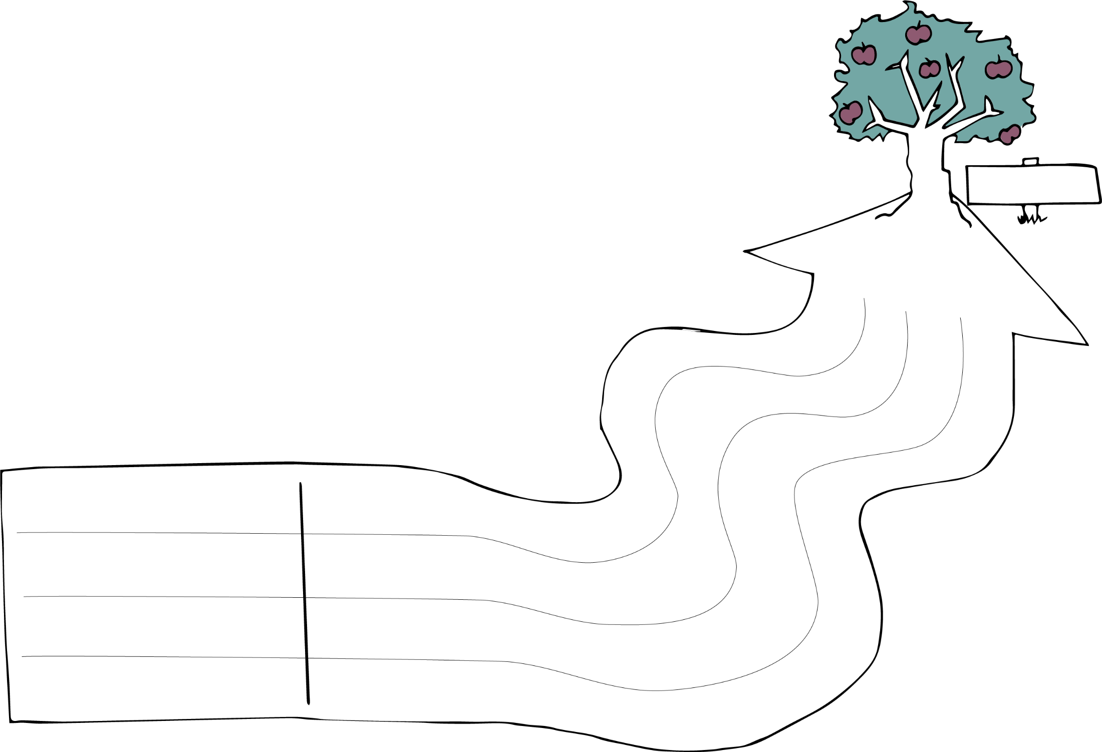
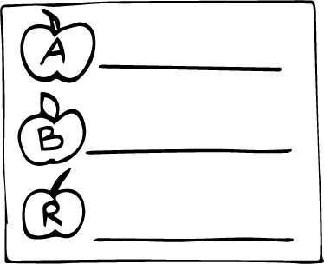
Our change journey
Who are we?
Time frame
Goal
Message
Tactics
Steps
Problem
Risks
Notes:
CONCLUSION
We have now worked through the process of creating an action plan.
For our change journey we’ve identified:
Our starting point – the problem
Our destination – the goal
The people we will meet on the way – friends, opponents and people we want to influence in some way
The route – the tactics we are going to use and the concrete steps we need to take to move forwards
We’ve also thought about our message and about risks we might encounter on the way.
This process can be used to create a simple or an in-depth action plan for any type of problem and type of tactic you want to use.
So, now it’s time for you to try it out yourself – creating your own change journey action plan for a problem that you want to tackle!

Slide 25
10 steps for the journey
Changemakers
Main problem
Problematic attitudes, behaviours and rules
Goal
Desired attitudes, behaviour and rules
6. People involved
7. Tactics and activities
8. Message
9. Steps
10. Risks
Notes:
Group work: our change journey Introduce the exercise with the help of slides 24 and 25.
Show slide 24 again while explaining the following:
Earlier in the session, we chose problems and divided into groups. Now each group will try to develop an action plan to tackle their problem, using the ‘Our Change Journey’ model we heard about in the presentation.
These action plans could be real plans that we want to implement after the training, or practice action plans that help us learn action planning skills we can apply later.
On the group tables, you will find a long flip chart sheet on which to draw and write your change journey. You will also find copies of the ‘Our change journey’ template to help you and as a handout for you to take home.
Your task is to create an action plan to tackle your group’s problem on your flip chart sheets, using the different elements of the change journey model. You will have the rest of this session and the first part of the next session to do this – that’s about 1 hour and 10 minutes in total.
Show slide 25 while explaining the following:
The steps to take to make your plan are as follows.
Decide who the changemakers are: who are the group of people or organisation who will implement the plan?
Write the main problem that your group has been given to work with.
Identify concrete attitudes, behaviours or rules that you want to change.
Create a goal to mirror your problem.
Identify the desired attitudes, behaviours and rules.
Add the other ‘people’ involved – the people affected, the people, organisations or authorities who are part of the problem or have the power to make a difference.
Choose and add your tactics and the main activities to be done in order to achieve the goal.
Identify a few key practical steps needed to implement these activities – but don’t spend too long on this today!
Identify what your messages are to the different people involved. What arguments will convince them?
And finally, think about what risks you might face along the way.
You don’t have to do things in this order, but it’s probably helpful!
Emphasise the following: It would be possible to spend a long time reflecting on each question, but the aim of this exercise is to create the ‘bones’ of a plan, the big picture which we can reflect on and develop more later if we decide to implement it. Aim to spend about 8 minutes on each part! Remember, this is a brainstorm of a rough plan! Write down your spontaneous thoughts and ideas and don’t spend time formulating things carefully – a roughly formulated single sentence or a few bullet points is enough.
And don’t forget the action ideas we’ve got on the flip charts! Perhaps you can use one or two of them in your plan.

Slide 26
Well done and welcome back!
Next session: Our Change Journey (continued)

